Slide 1

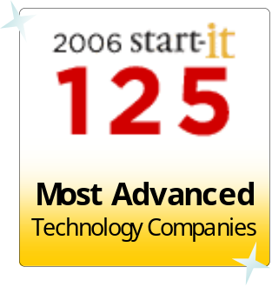




Aras Overview
Solutions for Performance Driven Companies
Microsoft Enterprise Open Source
August 2007

Slide 2




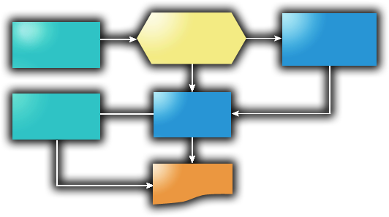





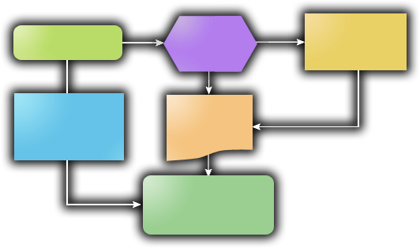





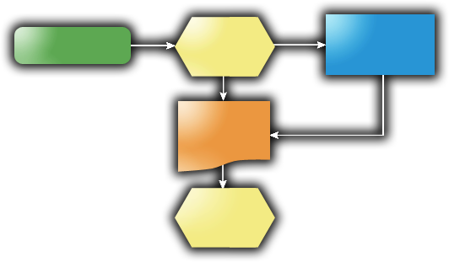
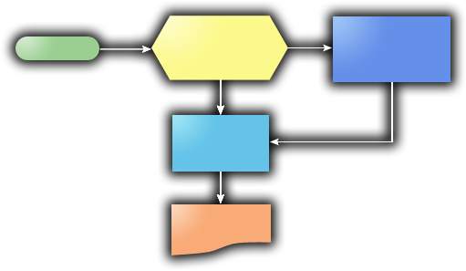

New Product Introduction & Quality Compliance Processes
Concept
Design
Development
Launch
Manufacture
Field Use
Phase-based Program Management
CAD File
Management
Document Mgt
File Vault
CMII Change Mgt
JD Edwards
“The Void”
No Visibility
No Repeatable Processes
Not Lean
Customer Complaints
Requirements
&
Specifications
BOMs & Parts
AVL / AML
Qualified
Suppliers
Part
Approval
Reports &
Dashboards
FMEA
Process Flows
Control
Plans
CAPA
Corrective Actions

Slide 3



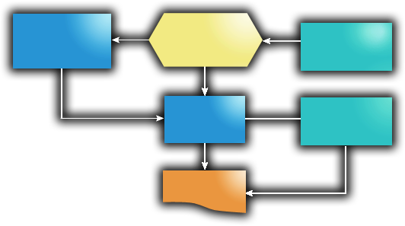
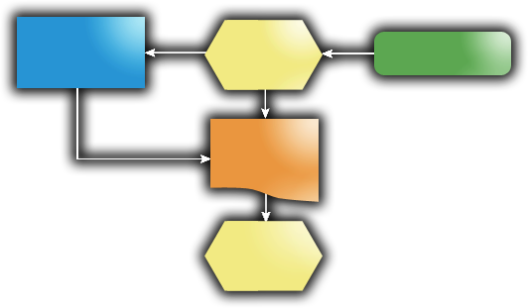
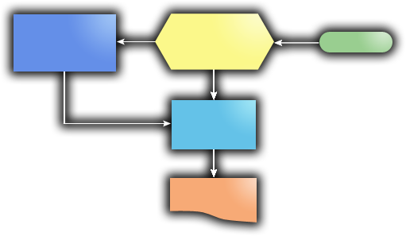
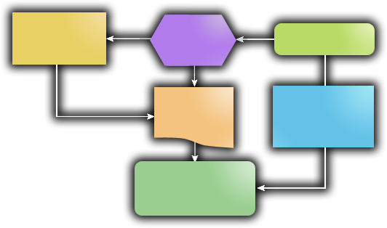
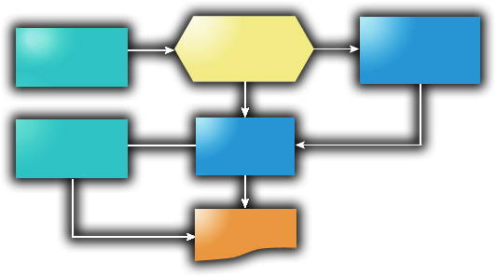
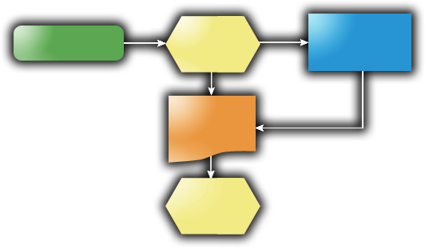
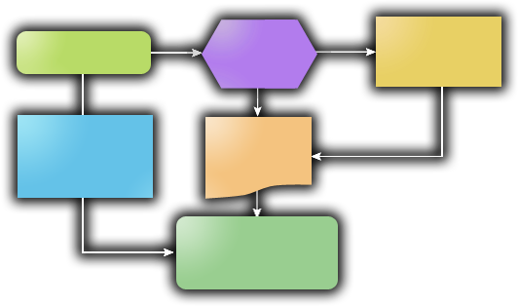

Complements Existing Enterprise Systems
Market Driven Changes
Customer Demands
Competition
Reorgs &
Mergers
New
Regulations
Outsourcing
New Product
Introduction
Quality
Compliance
PDM
ERP
CRM
Conventional Enterprise Systems
  Challenging to Deploy
  Difficult to Adapt
  Complicated to Upgrade
Aras Enterprise Solutions
  Deploy Quickly
  Adapt Easily
  Upgrade Simply

Slide 4




















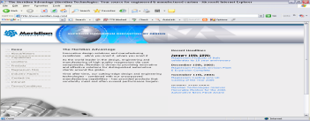





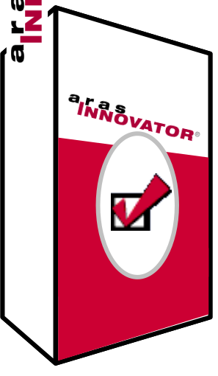
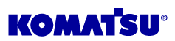













Aras Customers
New Era Ohio, LLC
Recent Downloads

Slide 5



Microsoft Enterprise Solutions
Business Benefits
No Surprises
Microsoft Enterprise Open Source
  Enterprise Production Ready
  Complete Solution Access
INCLUDED
  Unlimited Users
  No Up-Front Capital Needed
  Use Existing Infrastructure & Skills
  Delivers Control & Flexibility
BENEFITS

Slide 6




Service & Support
Deployment Services
Process Consulting
Integration & Migration
Support Subscription Packages
Consulting
Live Hotline
Email Support
Online Support Portal
Patches, Hot Fixes, Updates
Discounted Consulting
Discounted Training
Additional Productivity Tools
Enterprise–Class Support
Low Monthly Expense
Comprehensive & Complete
Solution Training
Administration
Developer Education
Predictable Fixed Cost
Training
Cost Per Production System
Enterprise
Edition
Small Business
Edition
Size
> $100M
< $100M
Month
$8,300
$4,100

Slide 7

Integration of Solutions
Coordinate & Collaborate on
New Product Programs
APQP Activities & Deliverables
to support EN ISO 14971
DFMEA, PFMEA, PFD, Control Plan
all related to Parts within a Program
Assign, Manage and Track
8D Activities
5 Phase CAPA
Program
Management
Quality Events can Result in
Modification of 21 CFR Part 820
documents, FMEA libraries or templates
Quality
Systems
Quality
Planning
Dual signature capabilities for
21 CFR Part 11 compliance
Quality Planning documents
related to the appropriate Part
in a Product Structure
Quality Events including
Customer Complaints,
Nonconforming Material,
and Audits can initiate CAPA
CAPA can trigger
Engineering Changes
Product
Engineering
Closed Loop Processes for Product Quality Compliance

Slide 8
Product Tour
Aras Innovator Easy-to-Learn
  User Experience
  User Interface
Solutions Easy-to-Use
  Program Management
  Product Engineering
  Quality Planning
Administration Easy-to-Change
  Item changes
  Form changes
  Process changes

